Slide 1
Legal Research Using LexisNexis
A Brief Guide to the LexisNexis Legal Database

Slide 2
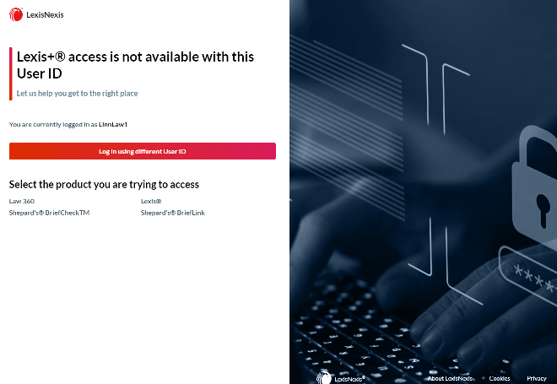
Selecting Your Product
To start searching in LexisNexis,
you will need to select the Lexis
icon.

Slide 3
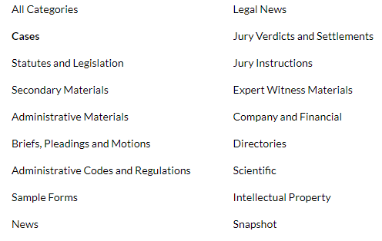
Legal Research Using LexisNexis
LexisNexis allows its users to search terms according to source name, citation, terms, or Shepard’s citation(s).
Users can also search terms within the following categories:

Slide 4
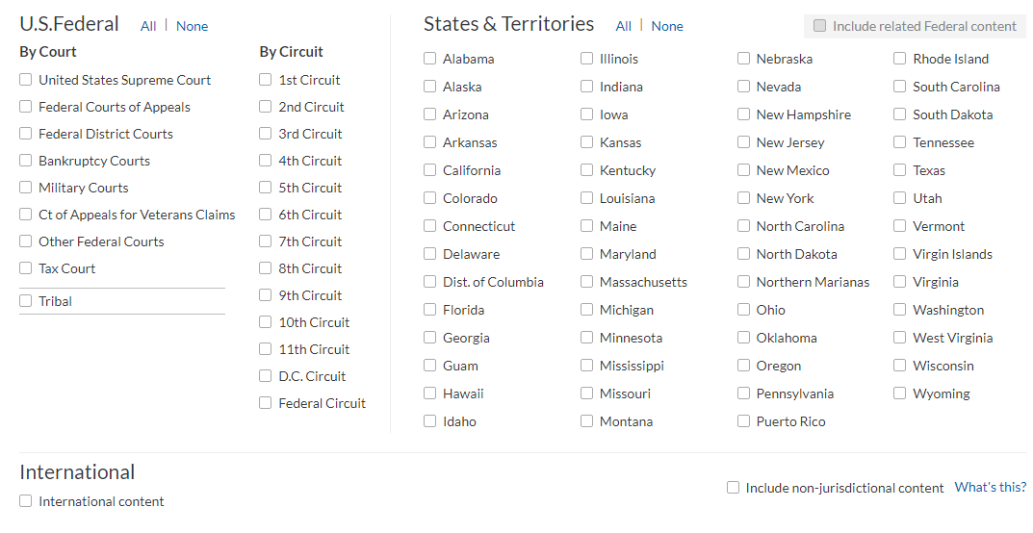
Legal Research Using LexisNexis (Continued)
Users can also narrow their searches according to a specific jurisdiction.

Slide 5
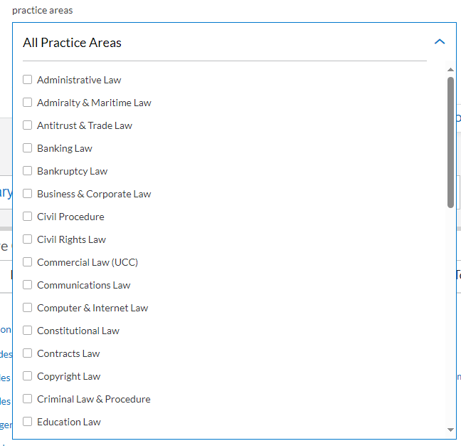

Legal Research Using LexisNexis (Continued)
In LexisNexis, users can also search by legal practice areas. This database allows researchers to narrow their search results by several filters.
Users of LexisNexis can even search by Practice Area(s) and set their favorite search terms

Slide 6
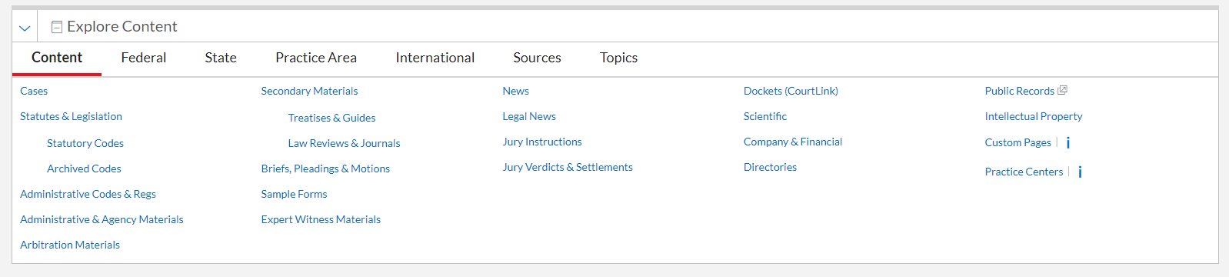
Legal Research Using LexisNexis: Content
Let’s look at the LexisNexis content the law library has subscribed to. Remember, you can narrow your searches however you like.

Slide 7
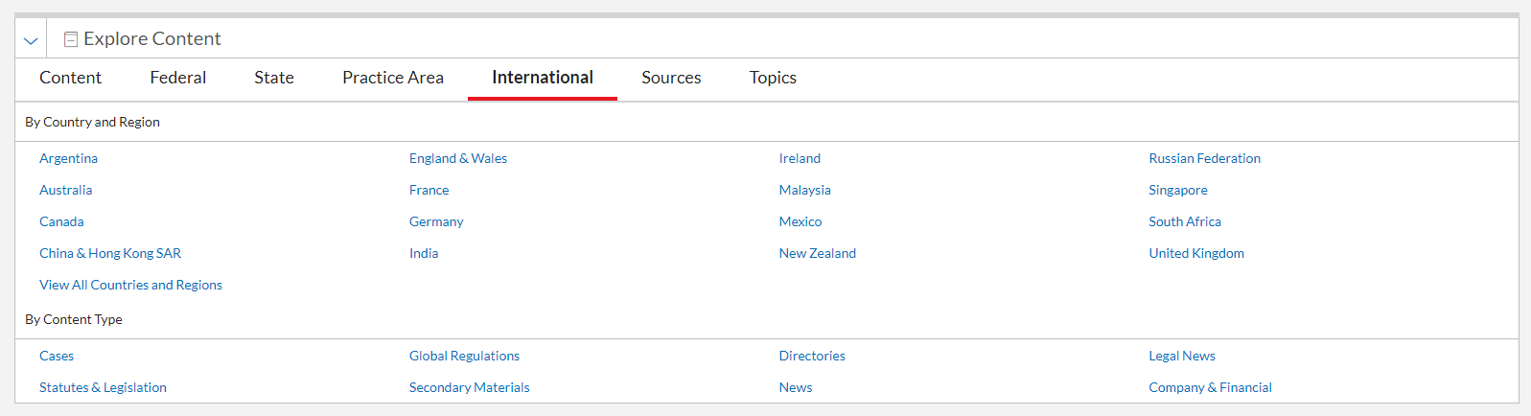
Legal Research Using LexisNexis: International Law
Users can search legal topics by country, region and type of content ….

Slide 8
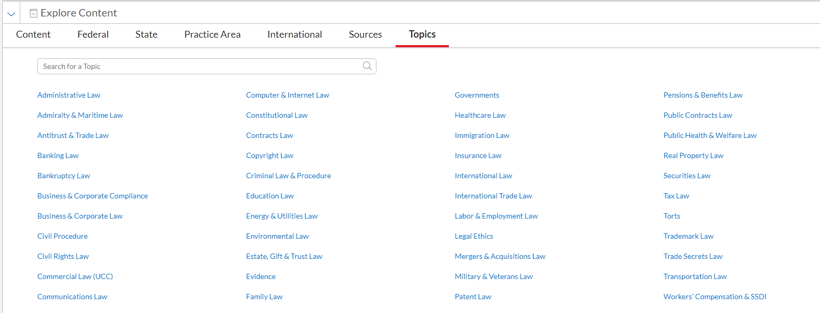
Legal Research Using LexisNexis: Topics
Finally, LexisNexis allows its users to search legal topics:

Slide 9
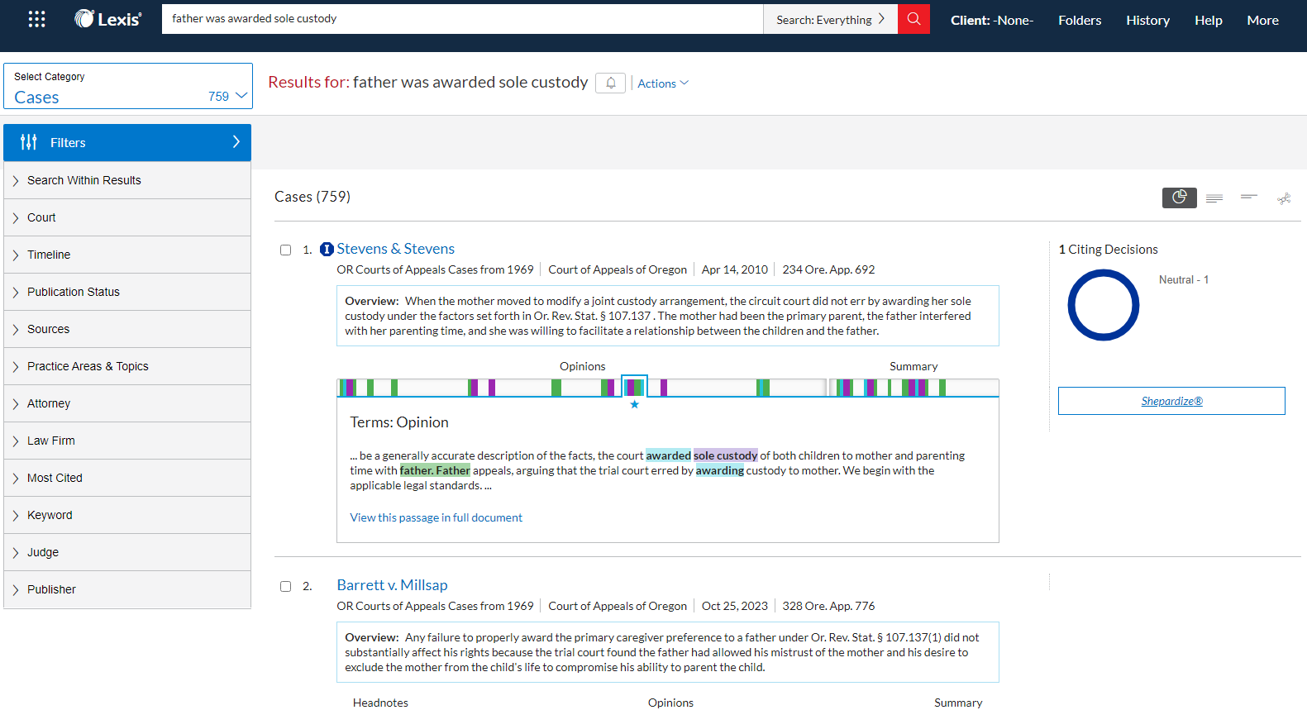
Legal Research Using LexisNexis: Searching
Here, I’ve searched for child custody cases in which the father was awarded sole custody, but I want to narrow my number of results

Slide 10
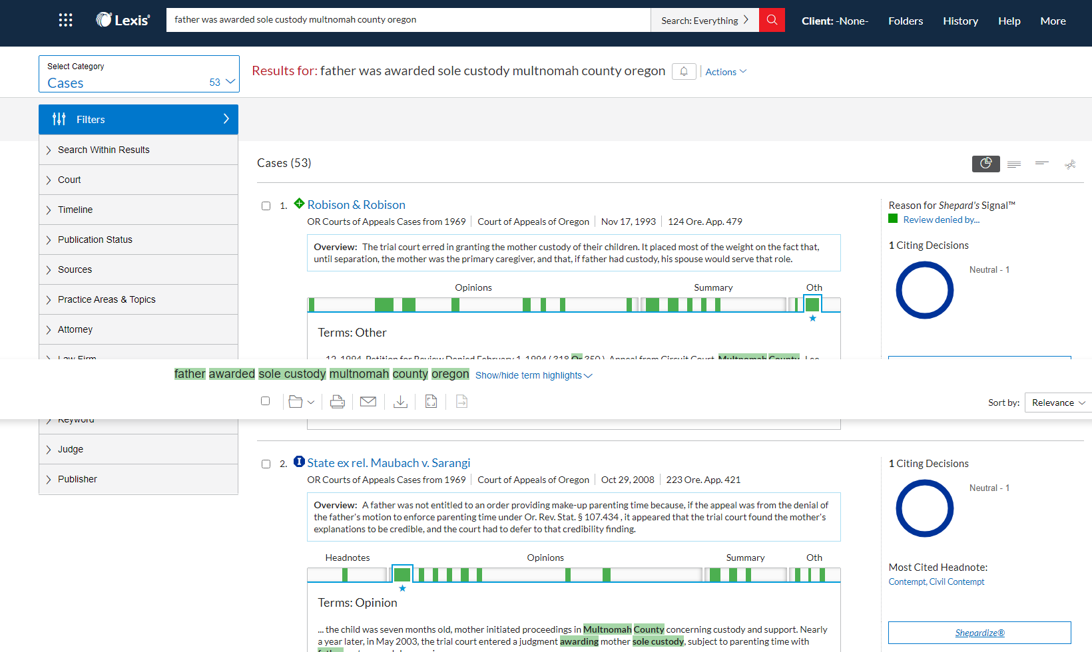
Legal Research Using LexisNexis: Searching
Now let’s try this ……. father awarded sole custody, multnomah county, Oregon. This search retrieved 53 results rather than 759.

Slide 11
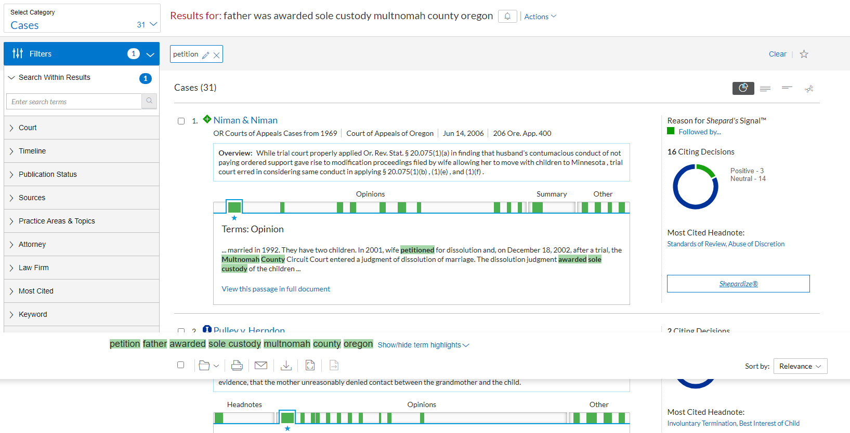
Legal Research Using LexisNexis: Searching Continued ……….
You can even search within your search results.

Slide 12
Searching Cases in LexisNexis: Positive and Negative Treatment
LexisNexis uses Shepard's Signal indicators to show the level of positive or negative treatment a case has received.
Red stop sign: Indicates a warning that the case has strong negative treatment, such as being reversed or overruled
Orange box with Q: Indicates that the case's validity has been questioned by citing references
Yellow triangle: Indicates a caution that the case may have possible negative treatment, such as being distinguished by or criticized by
Green diamond: Indicates that the case has positive treatment, such as being affirmed or followed by
Blue A circle: Indicates that the case has citing references with analysis available
Blue I circle: Indicates that the case has citation information available

Slide 13
Searching Cases in LexisNexis: Shepardizing
To Shepardize:
If you know the citation for the document you want to Shepardize:
In the search bar, type “shep: proper Bluebook cite.”
Example: shep: 410 U.S. 113.
To Shepardize when in a document:
Once you have located a document, click “Shepardize.”
The “Shepardize” button is usually at the top of the document.
Some types of documents also have a “Shepard’s Report” link on the right.
Remember that different types of documents have different citator information available.
Validating a Primary Source:
For a case, look at the negative citing references that are binding in your jurisdiction to make sure that the point of law you want to use is still good
law.
For a statute, look at any legislation that may have impacted the statute section you wish to use AND look at any cases that are binding in your
jurisdiction that have interpreted that statute section as unconstitutional or preempted.
Whether you are using Lexis or Westlaw, rely on the signals provided to lead you to those cases and legislation that may have impacted the primary
law that you are relying on for your research. See the boxes to the right for more detail about validating a law.
Expanding a Primary Source
You can also use Shepard’s to expand your research:
For a case, look at the citing decisions underneath specific headnotes, within a specific jurisdiction, or for a certain analysis.
For a statute, look at the analysis, look within a specific jurisdiction, or look at other citing sources to determine if there any other relevant/important
secondary sources.
Also see the tab on Using Headnotes, above, for more information about expanding your research.

Slide 14
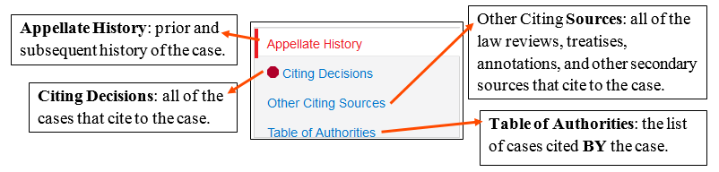
Searching Cases in LexisNexis: Shepardizing Continued …
Click "Shepardize this document" to get the full Shepard's Report. At the top left of the screen, you will see:

Slide 15
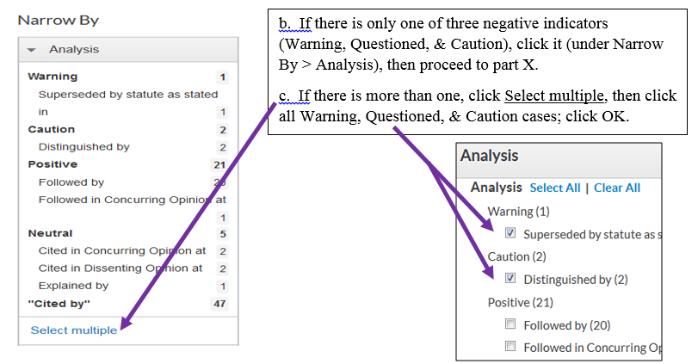
Searching Cases in LexisNexis: Shepardizing Continued …
To update a case, when the case has a red stop sign (Warning), an orange Q (questioned), or a yellow triangle (caution):
Click Citing Decisions → Under Narrow By, Analysis →

Slide 16
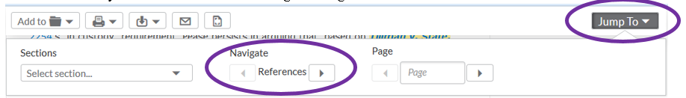
Searching Cases in LexisNexis: Narrowing Search Results
Narrow by jurisdiction (if necessary) so that you only see cases that are binding in
your jurisdiction.
Click on and read all of the remaining cases to determine what they say about the
case you wish to cite and whether the case you wish to cite is still good law for the
point you wish to cite it for.
TIP: When you click into a citing case this way, Lexis's reference navigation tool will allow you to skip directly to the part in the citing case that discusses your case. Click Jump To, then click the right arrow under Navigate:

Slide 17
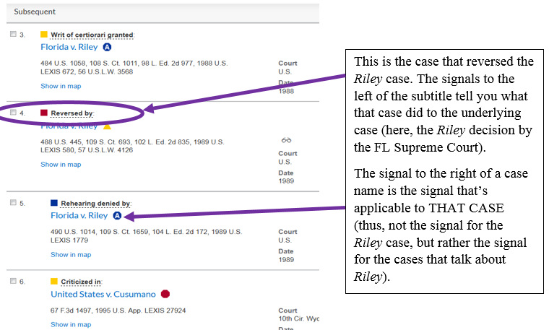
Searching Cases in LexisNexis: Appellate History
You may get several different options. The best bet is the click the case that has the red square to the left of what the case did:
Open the case with the red square. Lexis will automatically scroll you to the first point in the case where your case is cited. Read through and scroll to each part of the decision where your case is mentioned (sometimes, the entire decision will be applicable because it is overruling your entire case).

Slide 18
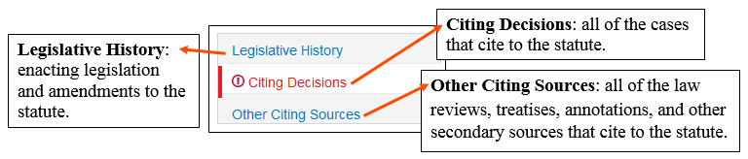
How to Update a Statute & Shepard's Report for Statutes
When you click "Shepardize this document" to get the full Shepard's Report of a statute, different information will be provided than was provided for cases. At the top left of the screen, you will see:
Once you have clicked on Citing Decisions or Other Citing Sources, you have the option to further filter the results. Citing Decisions allow you to Expand. Narrow by:
Analysis (what the case said about the statute: Warning, Positive, Neutral):
Court (both state and/or federal)
Search terms within the results
Timeline (limit to a specific date)
Other Citing Sources provides different filtering options:
Content (law review; court document; treatise; statute; annotation; secondary sources)
  Note: depending on the citing sources, different filters will be available
Search terms within the results
Timeline (limit to a specific date)

Slide 19
The Shepard’s Report
In a case, you can also use the Shepard's Report to filter Citing Decisions by a variety of options:
Citing Decisions allow you to Expand your case. Narrow By:
Analysis (warning; questioned; caution; positive; neutral)
Court (both state and/or federal)
Discussion (how much the citing decision considers the case)
  Analyzed: fully considers the case
  Discussed: some analysis of the case
  Mentions: brief mention of the case
  Cited: cites to the case with minimal if any discussion
Headnotes (if the citing case cites to a specific headnote)
Search terms within the results
Timeline (limit to a specific date)
Other Citing Sources provides different filtering options:
Content (law review; court document; treatise; statute; annotation; secondary sources)
  Note: depending on the citing sources, different filters will be available
Search terms within the results
Timeline (limit to a specific date)

Slide 20
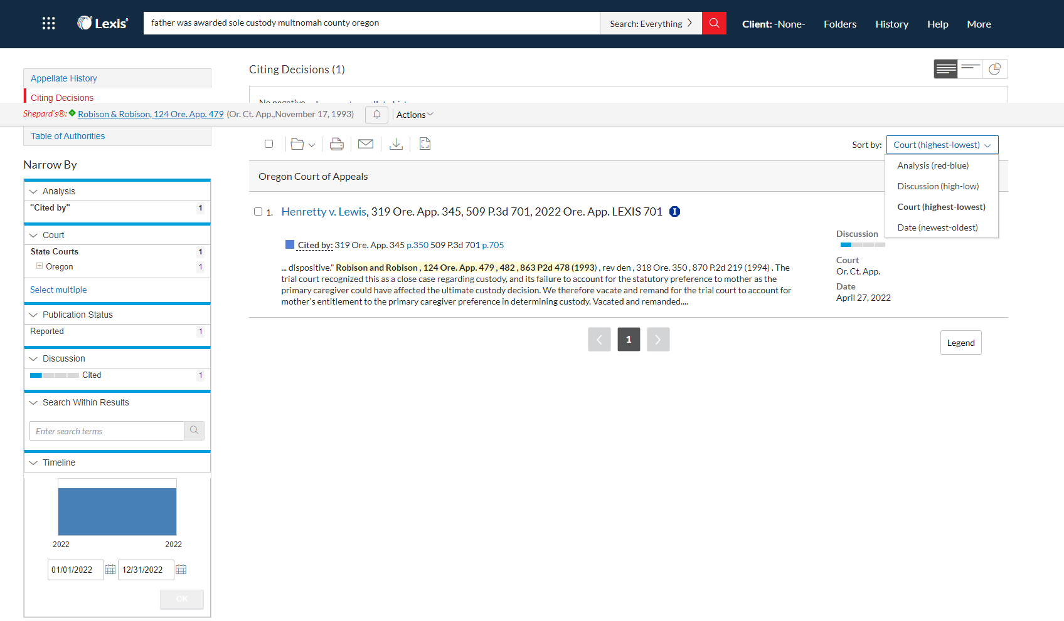
Shepard’s Report: Citing Decisions

Slide 21
Shepard’s: Validation Checks
Conducting a Validation Check:
The most common use for Shepard’s is a good law/bad law check. Shepard’s lists all the cases citing your case, and tells you what they are saying about your case. You must Shepardize® whenever citing to authority in a brief, memo or other legal document. • Sign-on with your ID & Password at www.lexisnexis.com/lawschool • Click the red Research Now button at the top right of the page. • Click the Shepard’s® tab at the top of the page. • Click Shepard’s® in the red bar underneath. • Type 22 F.3d 736 in the Enter Citation to be Checked form. • Click the red Check button. • View the Shepard’s Summary to see the complete view of your case. Note: The Shepard’s Summary displays both the good and the bad law ensuring you do not miss any important cases.

Slide 22
Shepard’s: Secondary Authority
Shepard’s also provides citing references to law review articles, Matthew Bender® treatises, statutes, briefs, pleadings, and other court documents. You can use these references to find additional secondary authority citing your case to ensure your research is complete. Exercise:
• Click the Shepard’s® tab at the top of the page.
• Type 390 U.S. 629 in the Enter Citation to be Checked form.
• Click the red Check button.
• Click the blue FOCUS™-Restrict By link at the top of the Shepard’s report.
• Enter video games in the FOCUS Terms box.
• Select Law Reviews under Jurisdictions available in FULL.
• Click the red Apply button.

Slide 23
Wrap Up ……….
Additional Resources
LexisNexis Legal Channel on YouTube
LexisNexis Quick Reference Guide
Shepardizing on LexisNexis
Shepard’s Signals and Analysis

